Slide 1

A Closer Look at Methods and Classes Part 3 Java - The Complete Reference Herbert Schildt Chapter 7

Slide 2
Outline
Introducing Nested and Inner Classes
Exploring the String Class
Using Command-Line Arguments

Slide 3
Introducing Nested and Inner Classes

Slide 4
Nested and Inner Classes
A Nested Class is defined within another class.
The scope of a nested class is bounded by the scope of its enclosing class.
Example: If class B is defined within class A, then B does not exist independently of A.
Thus, a nested class has access to the members, including private members, of the class in which it is nested.
However, the enclosing class does not have access to the members of the nested class.
It is also possible to declare a nested class that is local to a block.

Slide 5
static and Non-static Nested Classes
There are two types of nested classes: static and non-static.
A static nested class is one that has the static modifier applied.
Because it is static, it must access the non-static members of its enclosing class through an object.
That is, it cannot refer to non-static members of its enclosing class directly.
Because of this restriction, static nested classes are seldom used.
A non-static nested class is called an Inner Class.
It has access to all of the variables and methods of its outer class and may refer to them directly in the same way that other non-static members of the outer class do.

Slide 6
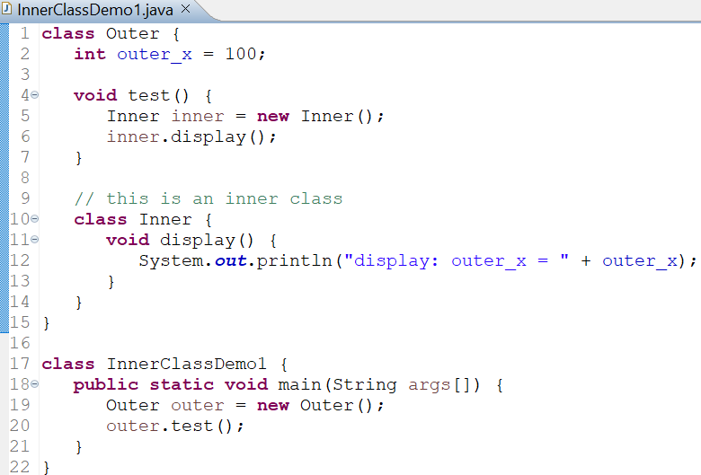
Inner Class: Example 1
OUTPUT
The inner class named Inner is defined within the scope of class Outer, so any code in class Inner can directly access the variable outer_x.
An instance of Inner can be created only in the context of class Outer. The Java compiler generates an error message otherwise.

Slide 7
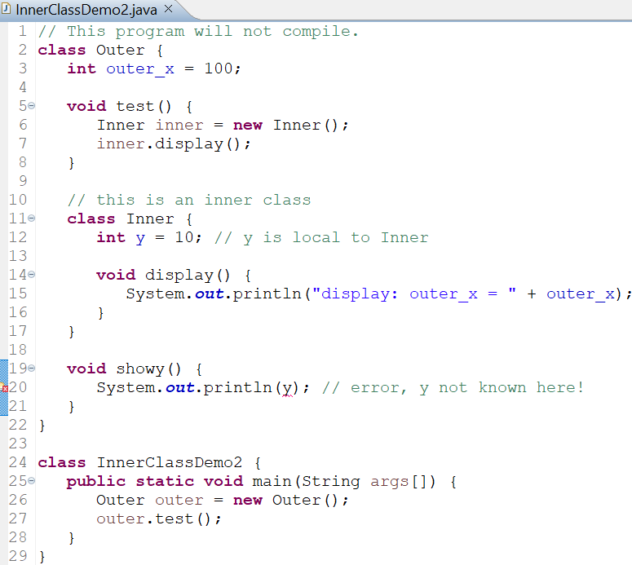
Inner Class: Example 2
An inner class has access to all of the members of its enclosing class, but the reverse is not true.
Members of the inner class are known only within the scope of the inner class and may not be used by the outer class.

Slide 8
Inner Class Scopes
So far, we have been focusing on inner classes declared as members within an outer class scope.
It is possible to define inner classes within any block scope.
For example, you can define a nested class within the block defined by a method or even within the body of a for loop.

Slide 9
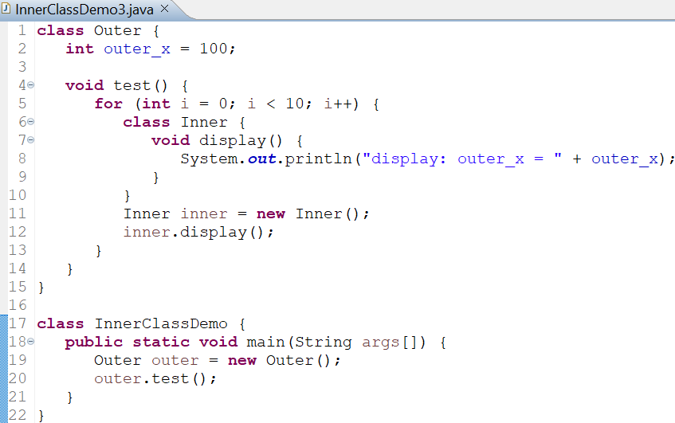

Inner Class: Example 3
OUTPUT

Slide 10
Exploring the String Class

Slide 11
String Class
String is probably the most commonly used class in Java’s class library.
Every string that we create in Java is actually an object of type String.
Even string constants are actually String objects.
System.out.println("This is a String, too");
The string "This is a String, too" is a String object.

Slide 12
Restrictions on String Class
Objects of type String are immutable: once a String object is created, its contents cannot be altered.
Solutions:
If you need to change a string, you can always create a new one that contains the modifications.
Java defines peer classes of String, called StringBuffer and StringBuilder, which allow strings to be altered, so all of the normal string manipulations are still available in Java.

Slide 13
Creating Strings
Strings can be constructed in a variety of ways:
The easiest is to use a statement like this:
String myString = "this is a test";
Once a String object is created, it can be used anywhere that a string is allowed.
System.out.println(myString);
Java defines concatenator operator (+) that can be applied to two strings.
String myString = "I" + " like " + "Java.";
It results in myString containing "I like Java."

Slide 14
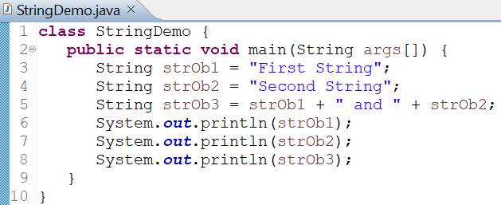
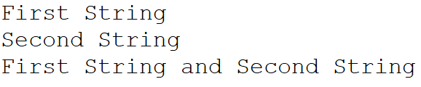
String Class: Example
OUTPUT

Slide 15
String Methods
Method equals() can be used to test two strings for equality.
boolean equals(secondStr)
The length() method can be called to obtain the length of a string.
int length()
The character at a specified index within a string can be obtained by calling charAt().
char charAt(index)

Slide 16
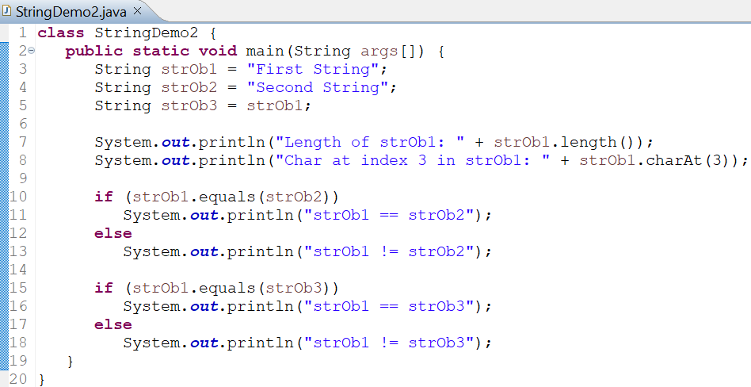
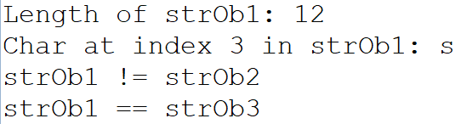
String Methods : Example
OUTPUT

Slide 17
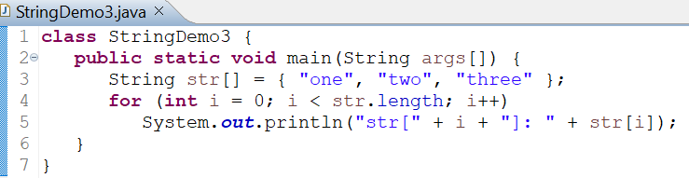

Arrays of Strings
We can have arrays of strings.
String arrays play an important part in many Java programs.
OUTPUT

Slide 18
Using Command-Line Arguments

Slide 19
Using Command-Line Arguments
Sometimes we will want to pass information into a program when you run it.
This is accomplished by passing command-line arguments to main().
A command-line argument is the information that directly follows the program’s name on the command line when it is executed.
To access the command-line arguments inside a Java program is quite easy: they are stored as strings in a String array passed to the args parameter of main().
The first command-line argument is stored at args[0], the second at args[1], and so on.

Slide 20
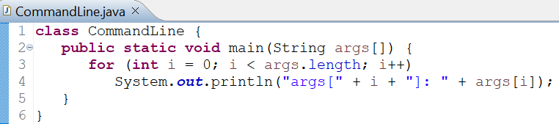
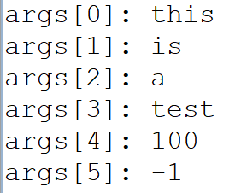
Using Command-Line Arguments
Try executing this program in Command Prompt (or Terminal in Linux/MacOS):
java CommandLine this is a test 100 -1
All command-line arguments are passed as strings.
We must convert numeric values to their internal forms manually (will be covered in upcoming classes).
OUTPUT

